Slide 1

R-Ladies Nairobi: Journey
NamibiaR Launch Event
April 23, 2022

Slide 2
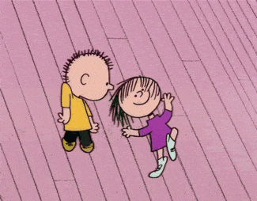
Congratulations!!!

Slide 3
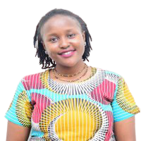

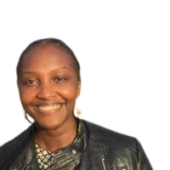
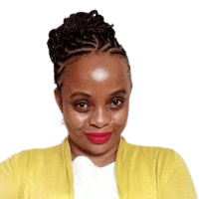
The organisers …
Njoki Lucy
Biostatistician
Faith Musili
Senior Data Analyst
Margaret Wanjiru
Risk Analyst
Shelmith Kariuki
Data Analytics Consultant

Slide 4
Steps…
Initial Meetings and interactions of Vision carriers
Constitute Organiser unit
Contacting R-Ladies Global: info.rladies.org
Recognition by R-Ladies Global, receive details such as CoC, email address etc
Launch the chapter (virtually or in person)
Advertise on social media
Continue developing contacts with other chapters
Hold the first meetup within six months after launch

Slide 5
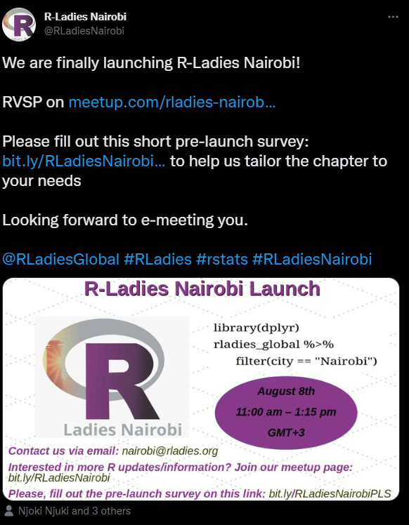

How we started!
Chapter Launch: August 8, 2020
1208 members
~ 850 based in Kenya

Slide 6
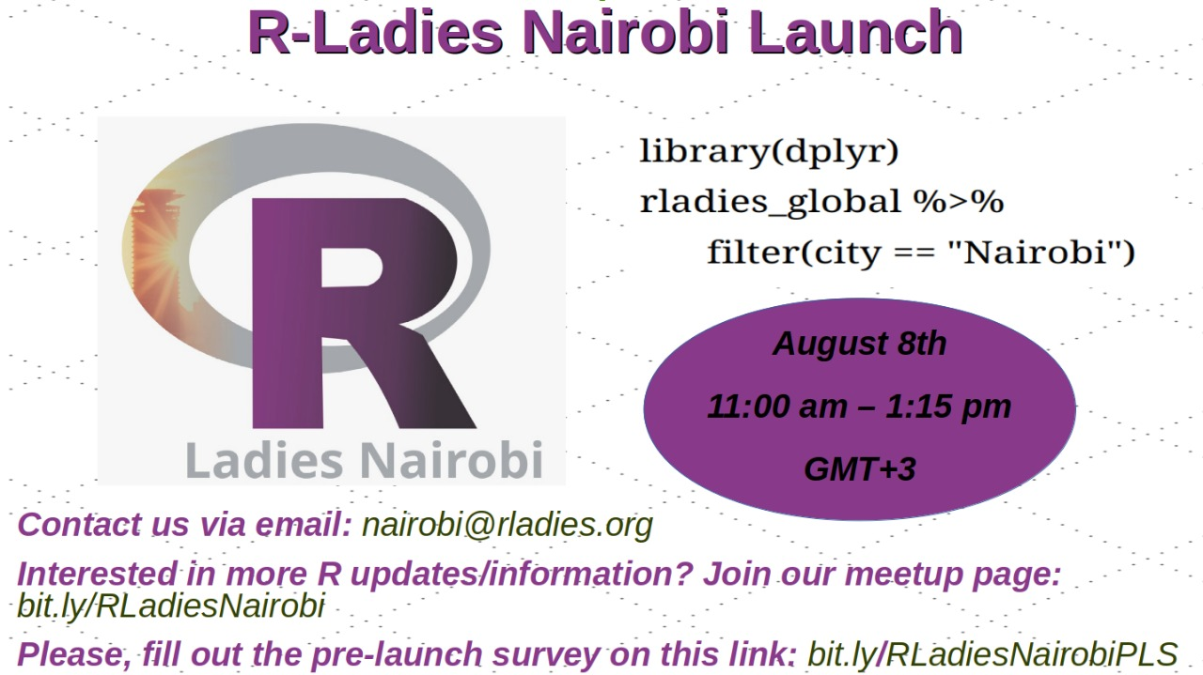
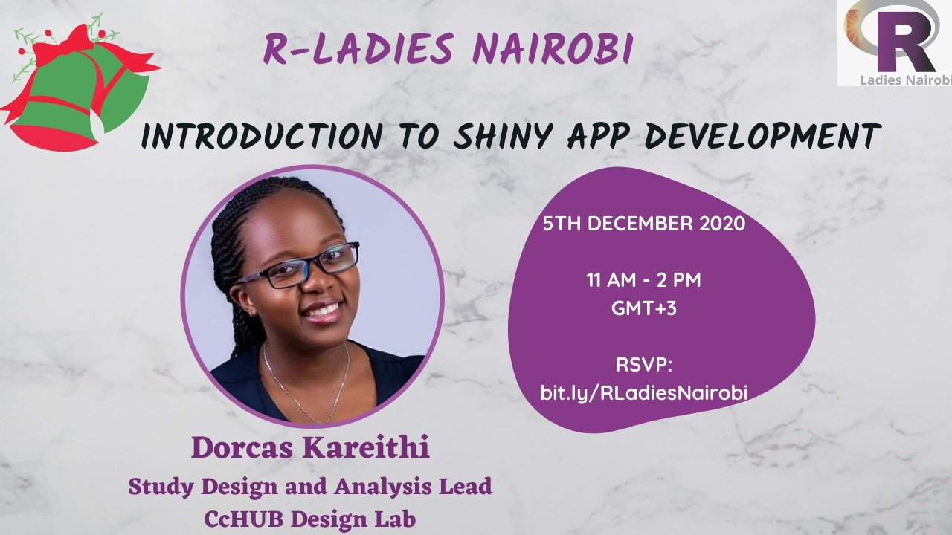
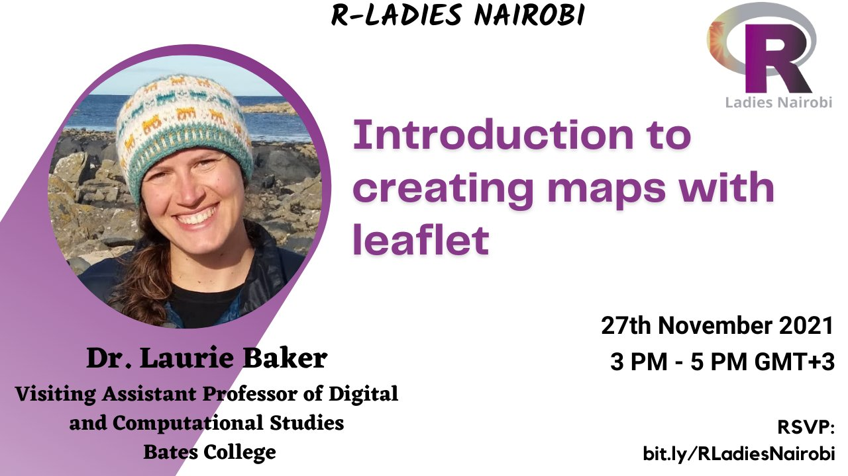
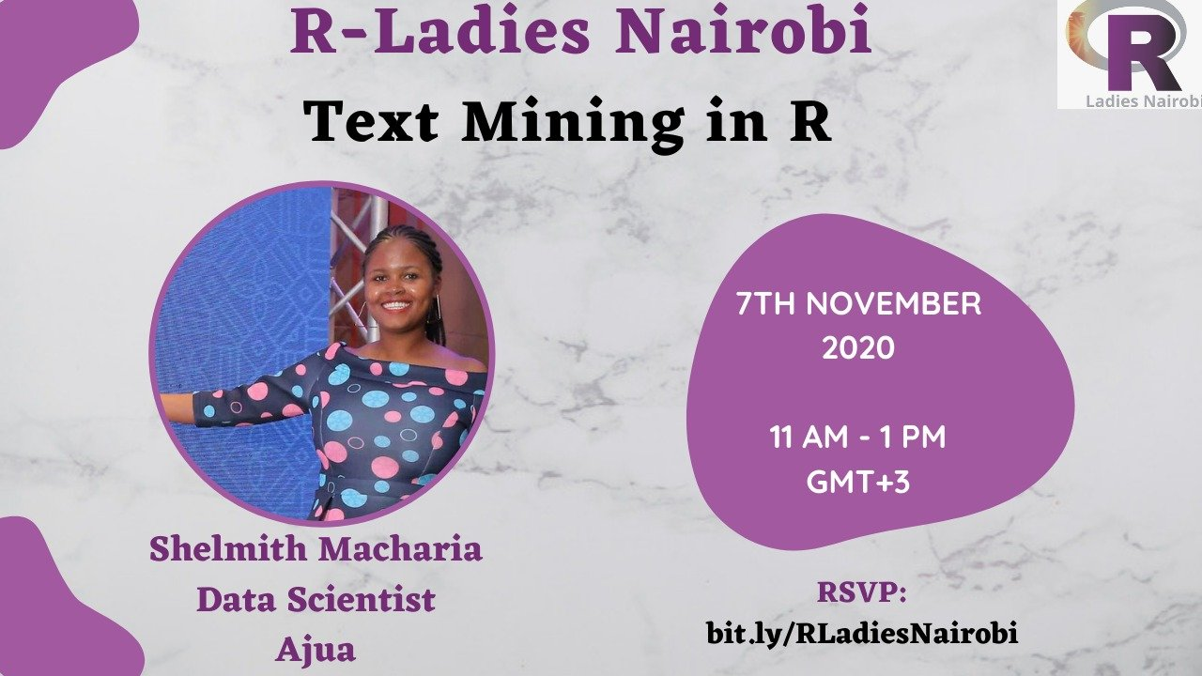


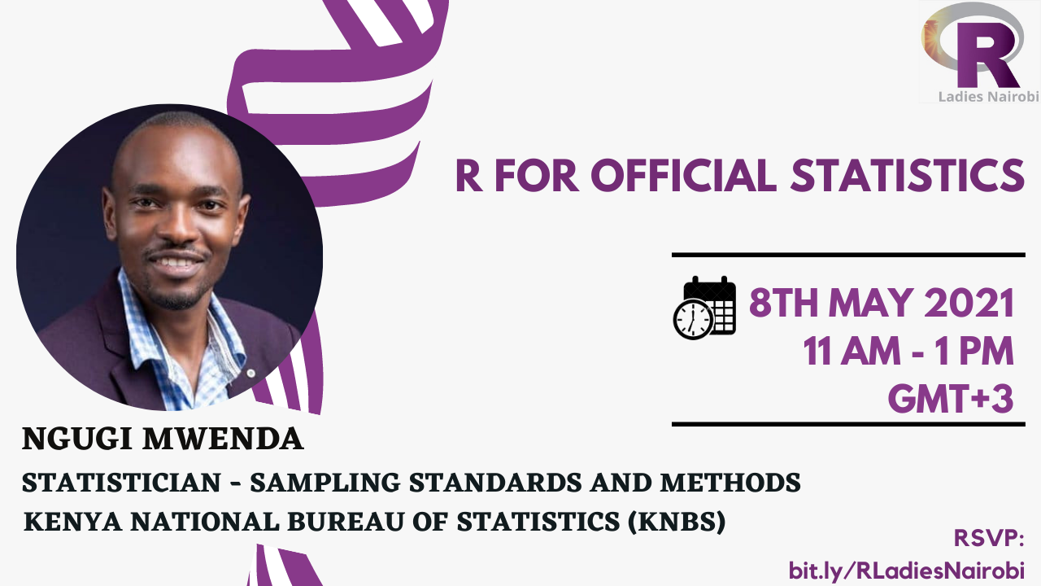
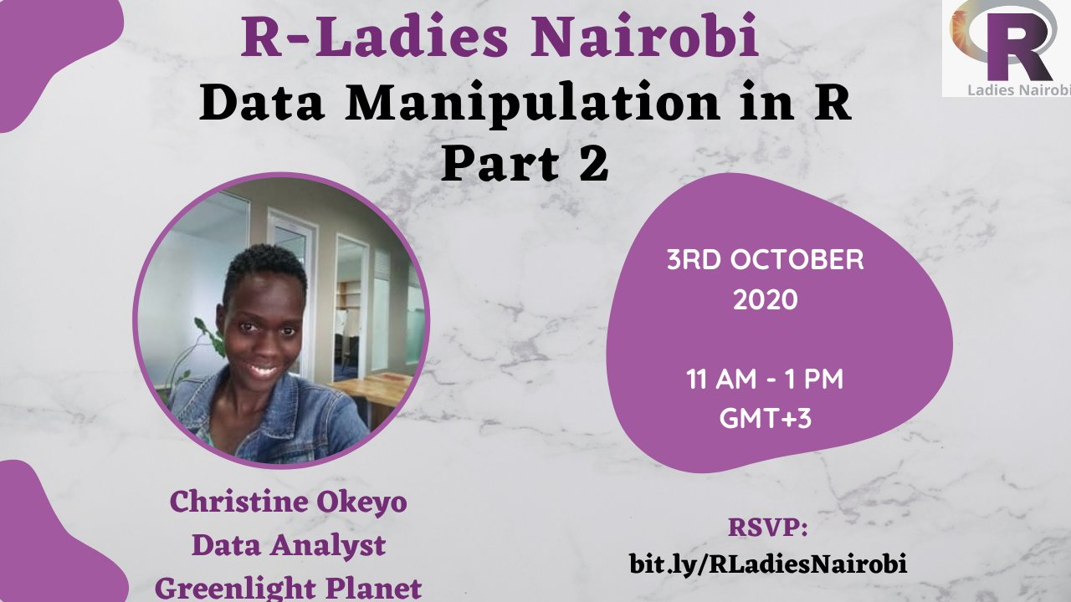

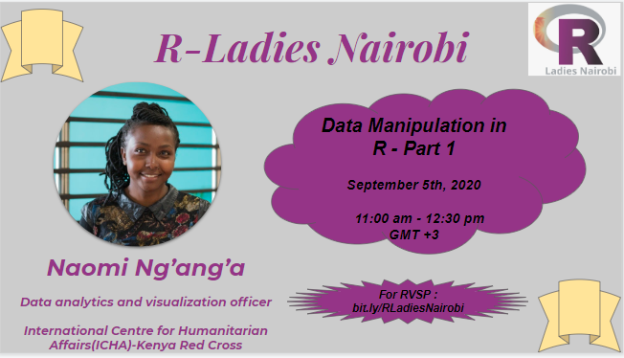
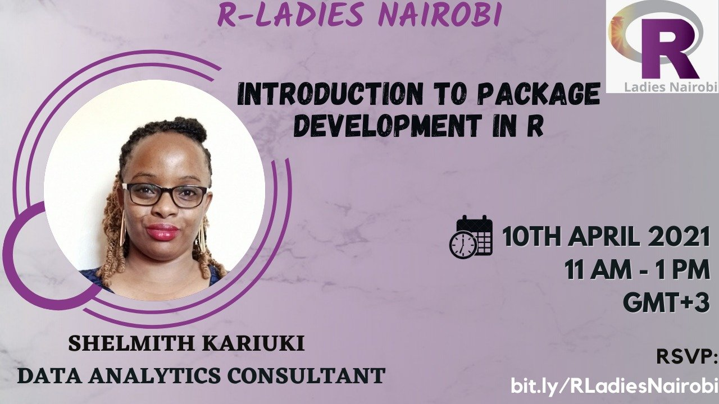
Past Events

Slide 7
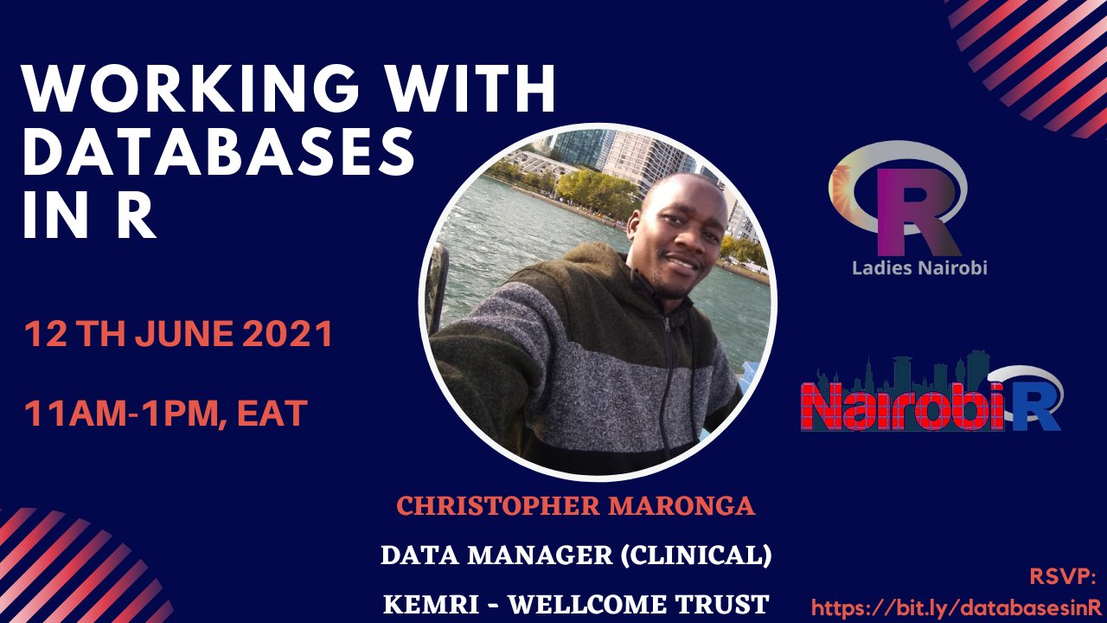

Collaborations with other R groups
Notes:
We have collaborated with other R-Ladies chapters in Africa and Nairobi R User Group for events.

Slide 8


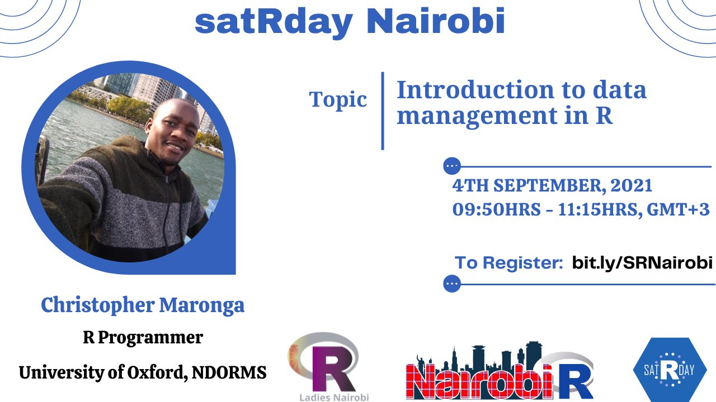
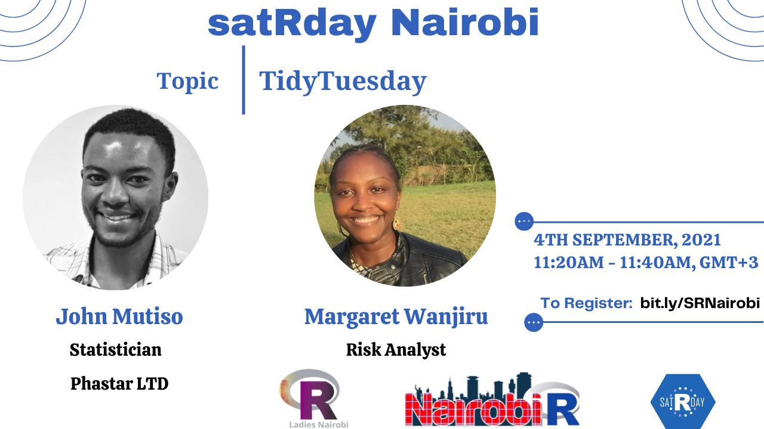
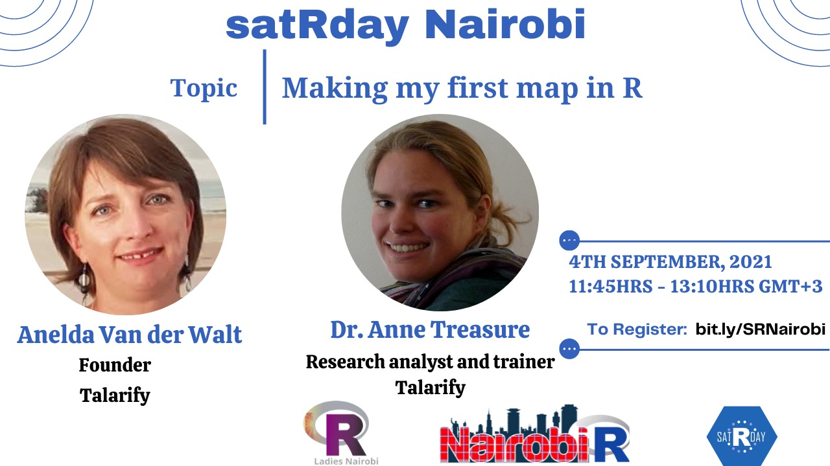
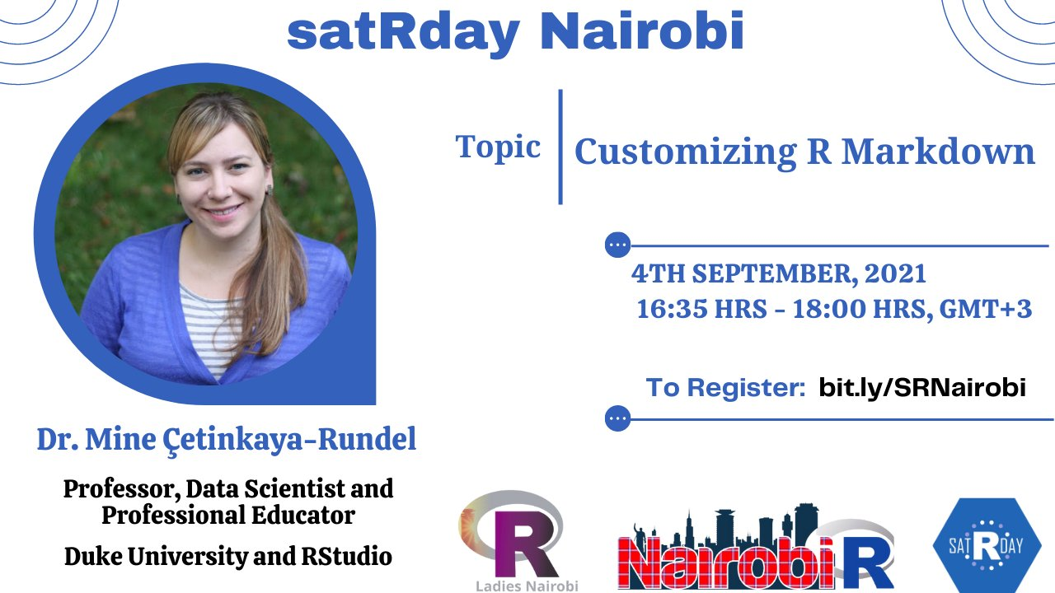
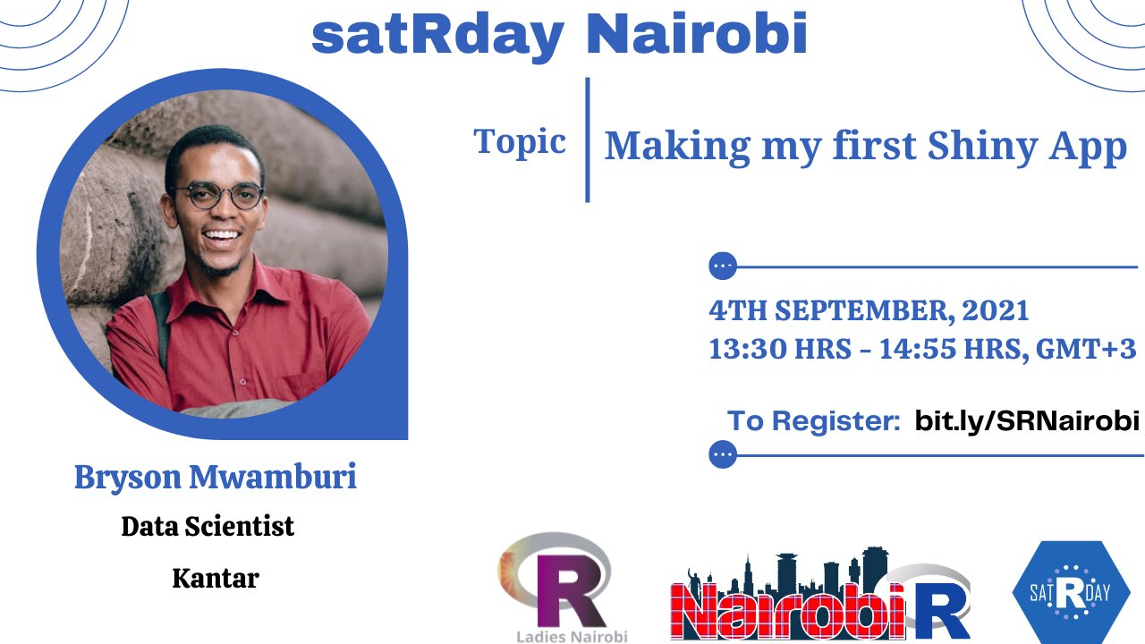
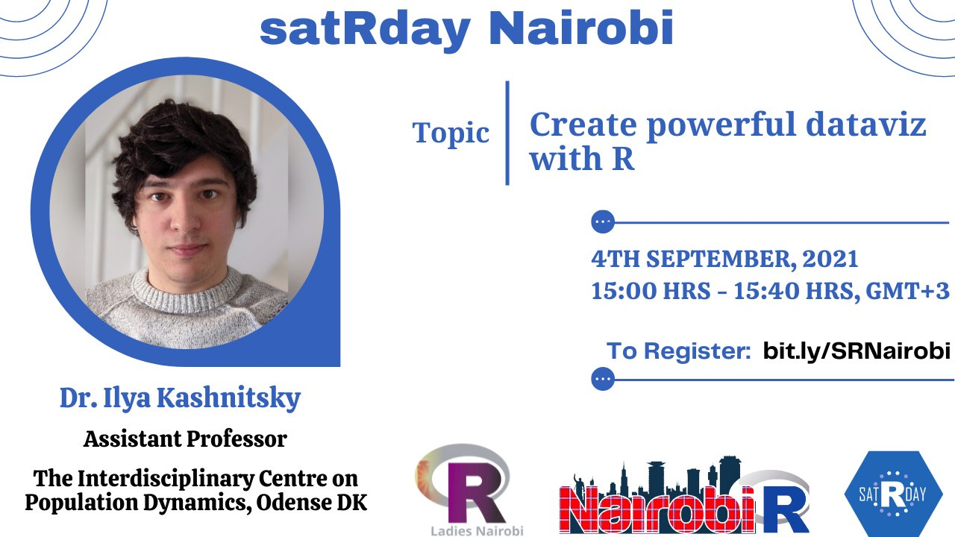

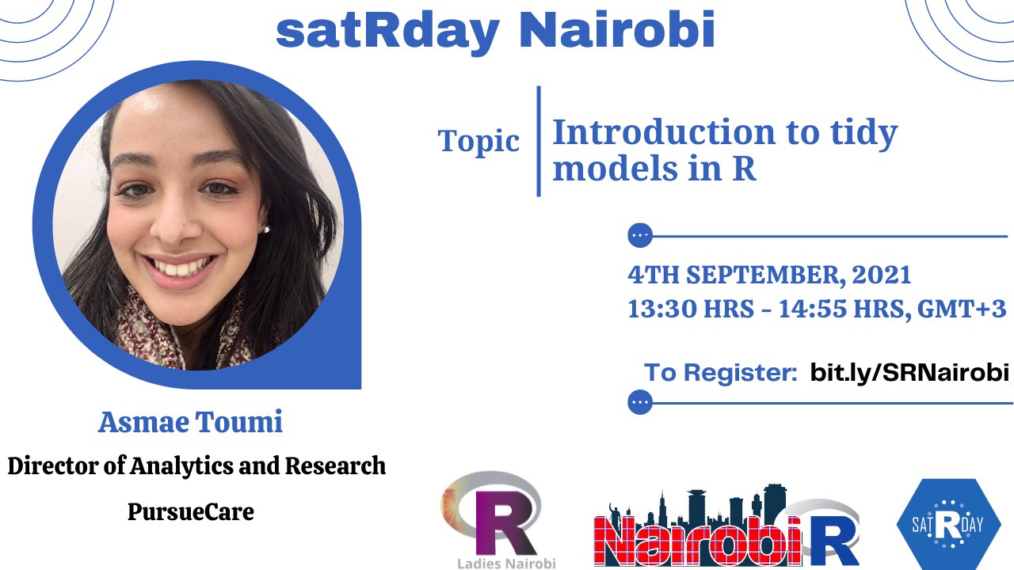
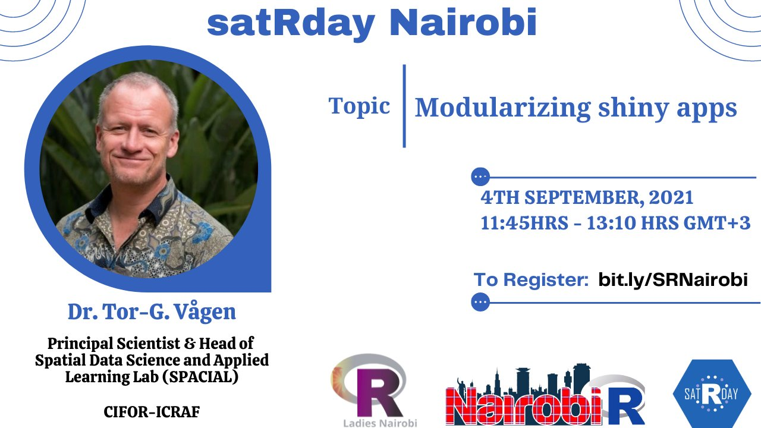

satRday Nairobi conference 2021
R-Ladies Nairobi
#NairobiR

Slide 9
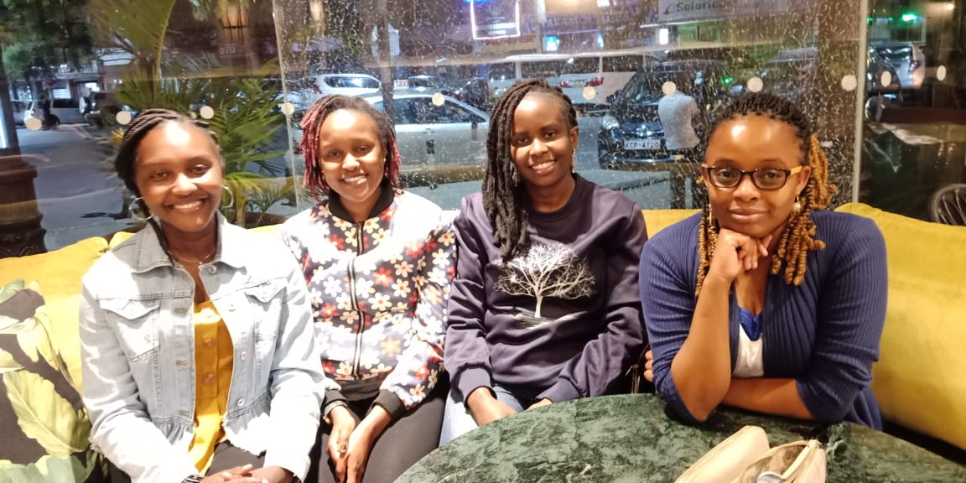
Remember !
Pillars of success
✨ Teamwork and Organisation
🌺Lifelong friendship
Communication
Morale 😎
💡Seeking help where necessary
Maggie, Njoki, Faith, Shel

Slide 10
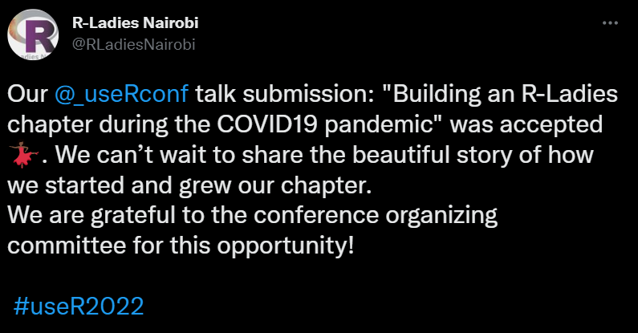
Accomplishments so far…
Our talk “Building an R-Ladies community during the COVID19 pandemic” was selected for useR! 2022.

Slide 11
Lessons learnt along the way!
The number of participants registered or joined a session should never demoralise you.
Organisers should always remember why they started it.
We do for charity.
A suggestion not to over do the meetups.
To avoid burnout!

Slide 12
THANK YOU!
Email address: nairobi@rladies.org
LinkedIn: R-Ladies Nairobi
Twitter: @RLadiesNairobi
Meetup: https://www.meetup.com/rladies-nairobi/

